Slide 1
Dream Catcher
Qinfeng Li, Dayu Li

Slide 2
Concept of the App
DreamCatcher is an app that helps users record, analyze, and explore their dreams.
After each time user wake up, they can log their dream content. The app uses AI to analyze keywords, recognize emotions, and generate images, helping users gradually understand patterns in their subconscious.
It also helps them create a "Dream Gallery," turning each dream into a unique, visual story.

Slide 3
Main Feature
01
02
Dream Log
Dream Visualize
03
04
Dream Pattern Tracking
Therapist Finder
Users can detail their dreams upon waking, adding keywords and emotional descriptions to facilitate review and analysis. The log supports voice input for quickly capturing early morning memories of dreams.
Based on the keywords and emotions in the dream, the app generate artwork, producing a personalized "dream painting" for each dream. Users can compile these into a "Dream Gallery" to revisit and share their dreams.
The app identifies recurring themes and emotional patterns in users' dreams, displaying changes and patterns over time on a timeline.
The app can recommend nearby therapists available for appointments base on the address they provided.

Slide 4
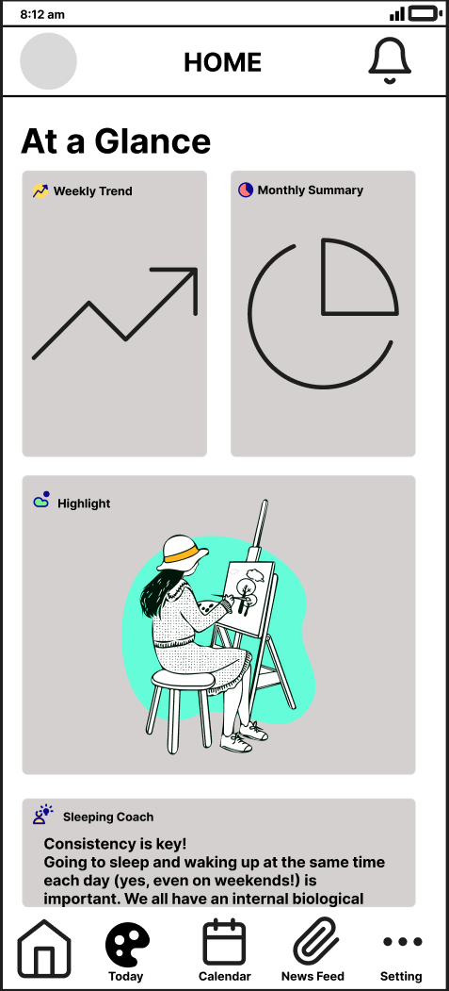
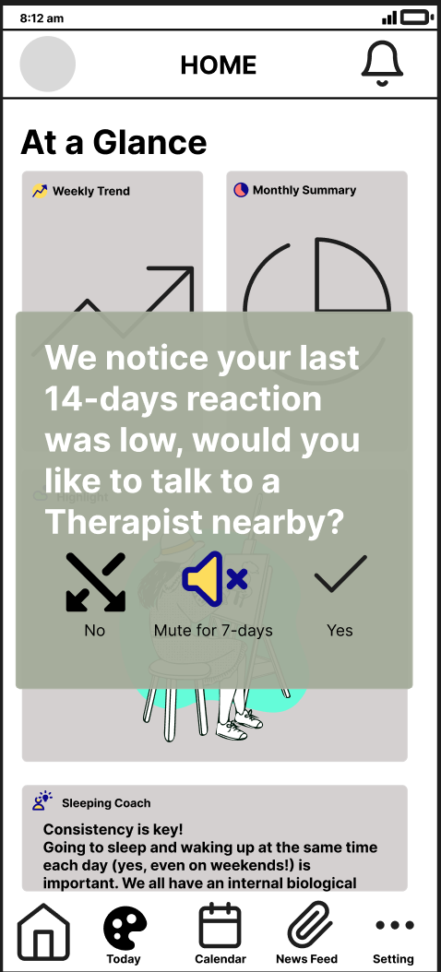
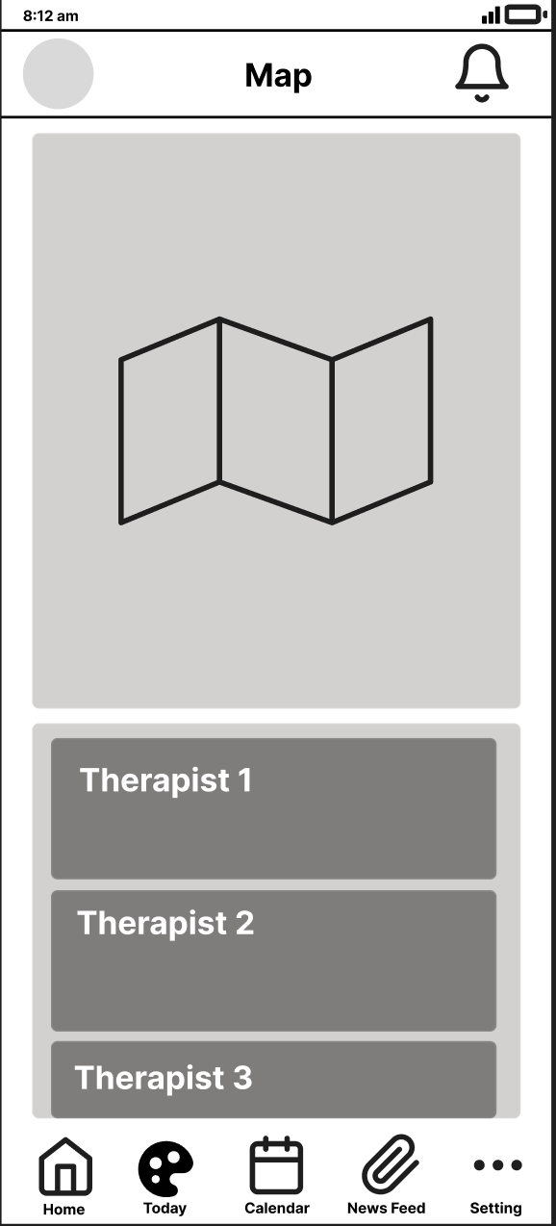

Slide 5
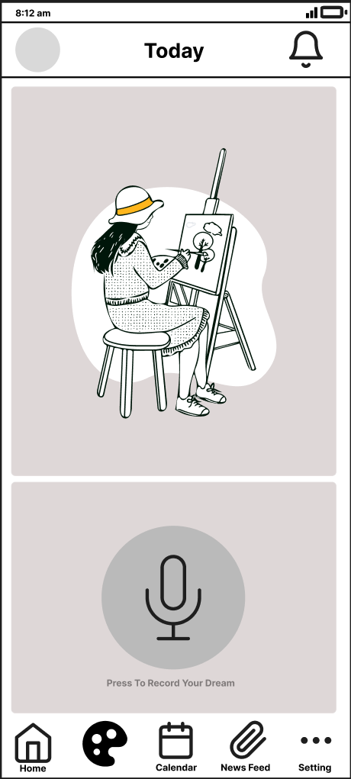
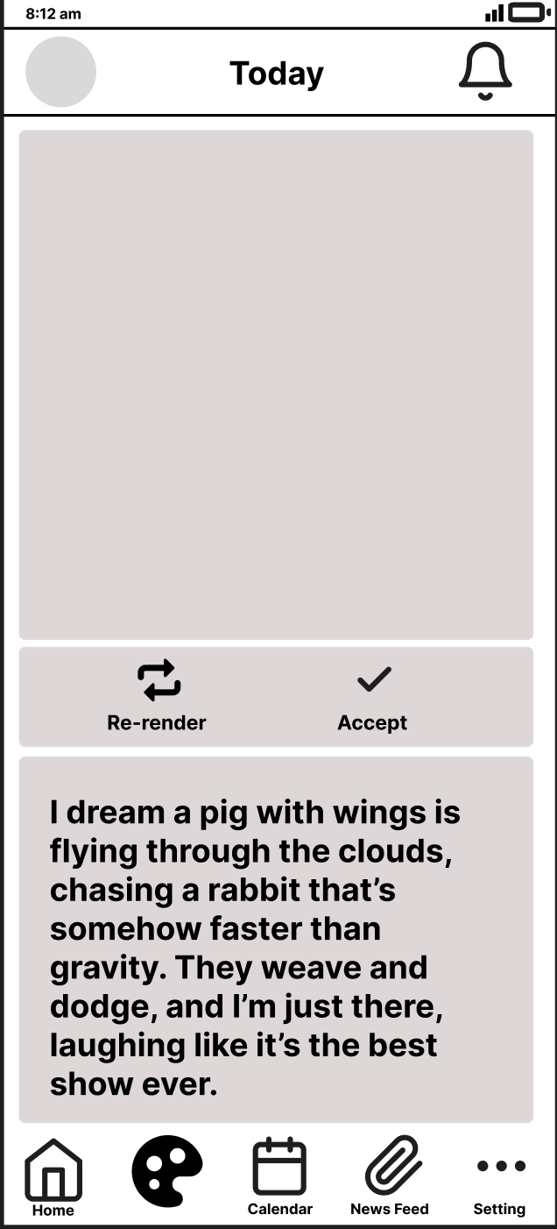
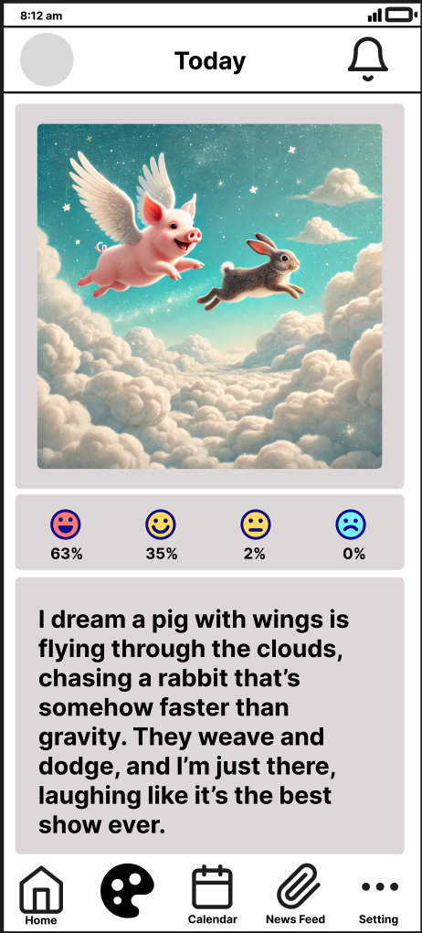
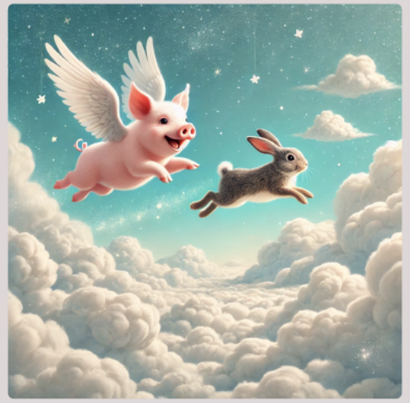

Slide 6
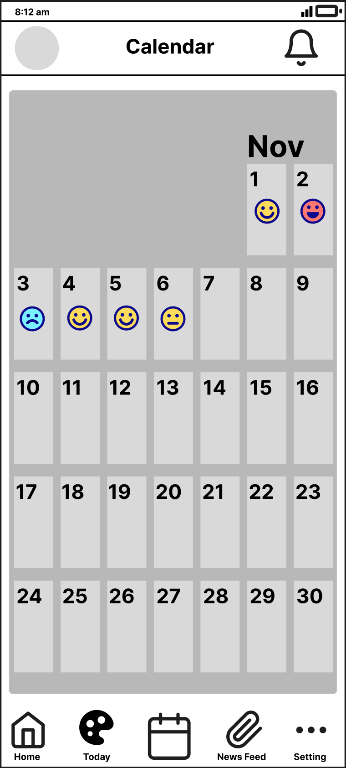
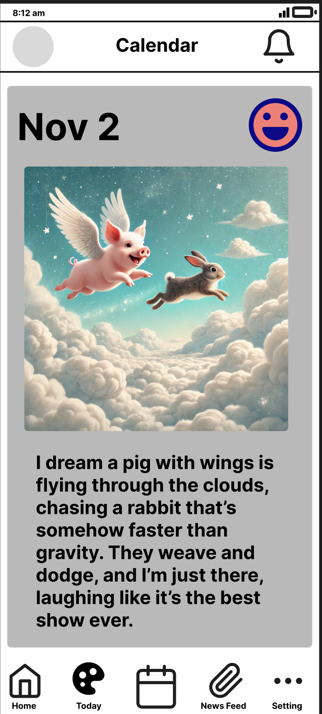
Calendar

Slide 7
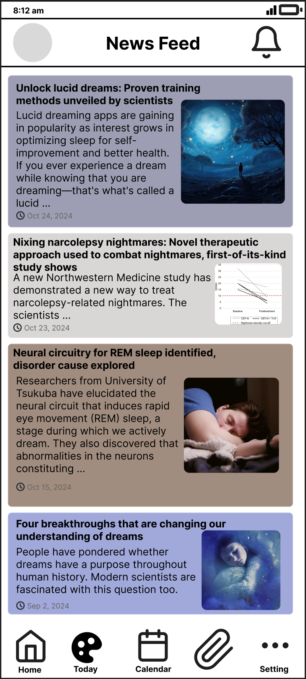
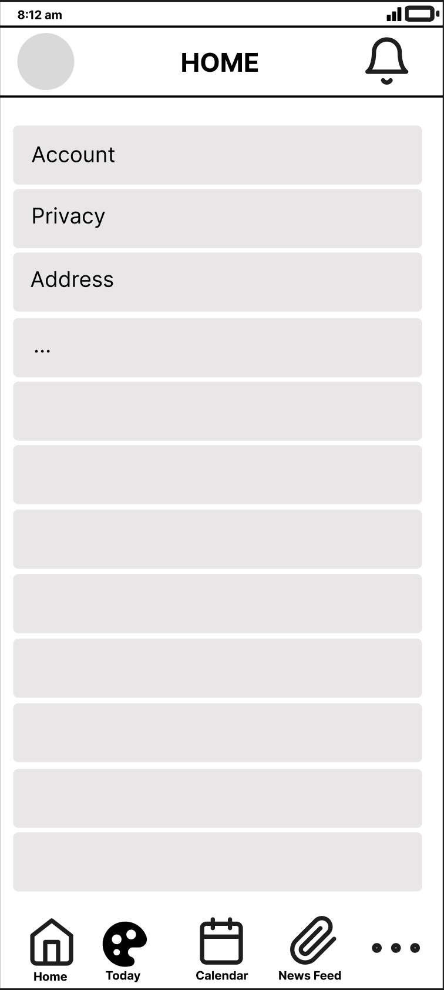
News & Setting

Slide 8
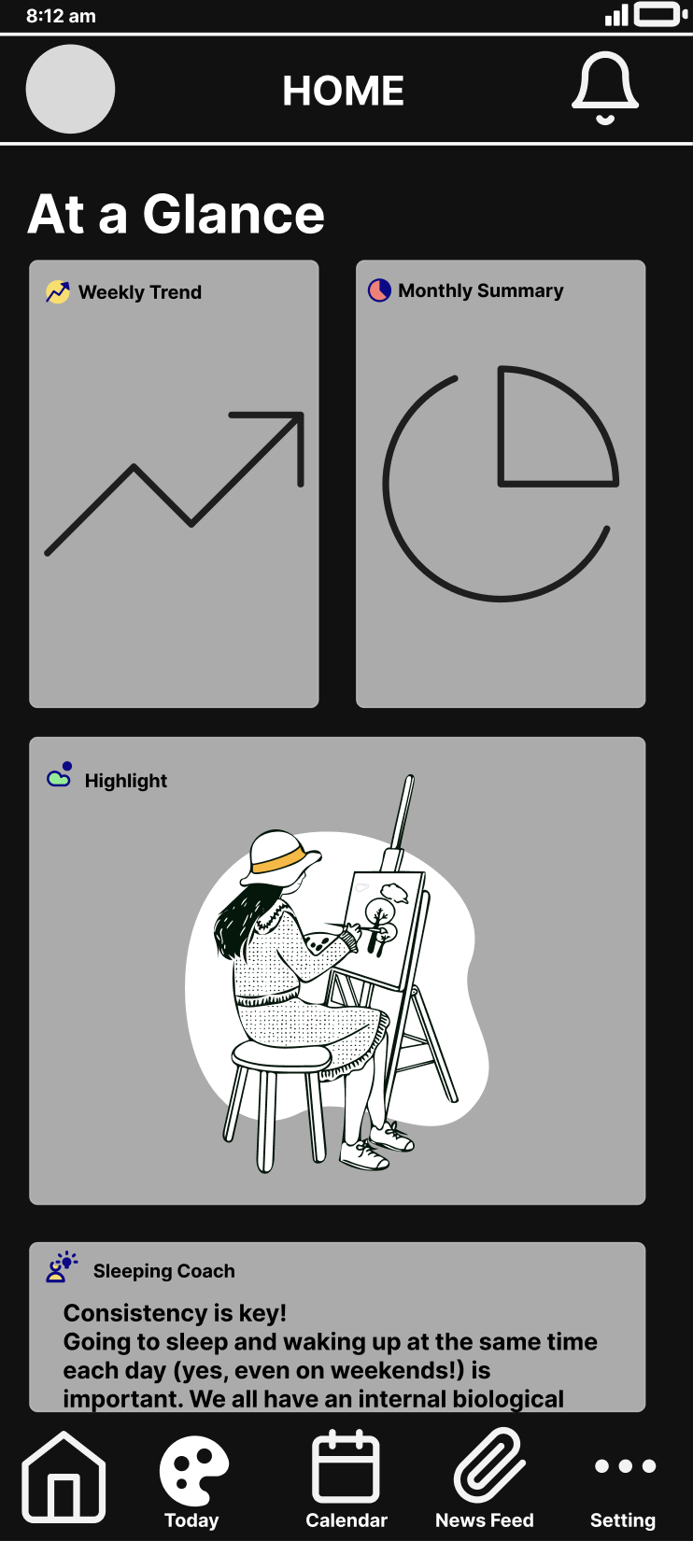
Dark Mode

Slide 9
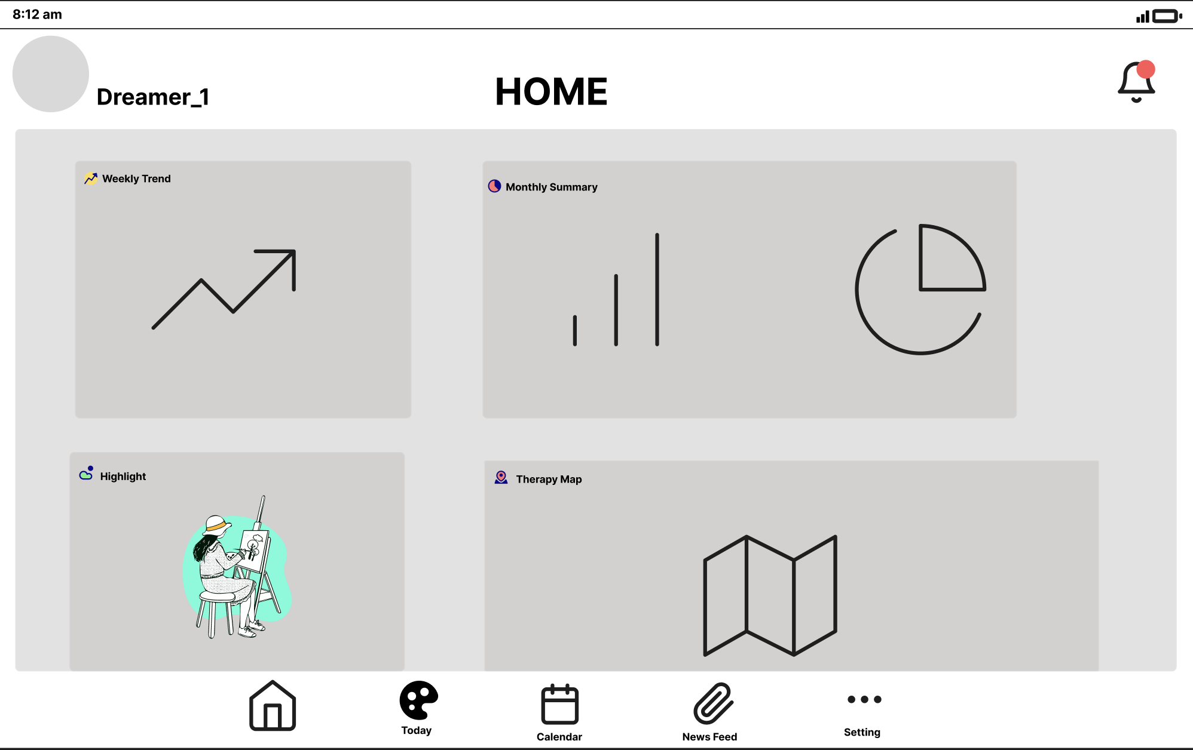
Tablet
Compact Phone

Slide 10
Target Audience
Individuals interested in exploring dreams and the subconscious; users who wish to record and understand their dreams, as well as those interested in mental health and emotional management.

Slide 11
Technical Specifications
APIs and Libraries:
Firebase Authentication: For secure user registration and login, with support for Google email verification to enhance account security.
Google Maps API: For locating nearby therapists or mental health professionals when mood trends indicate potential need for intervention.
Natural Language Processing (NLP): For keyword extraction from dream descriptions, aiding in AI art generation and mood analysis.
AI Art Generation API: To transform dream descriptions into creative images, allowing users to visualize and engage with their dreams in a unique way.
Tech Stack:
Android (Kotlin), Jetpack Compose for modern UI, Firebase for authentication and Firestore database for storing dream entries and mood data.
Data Storage:
Room Database: Caches dream entries and artwork locally to support offline access and retrieval.
Firebase Firestore: Synchronizes data securely across devices, enabling users to retrieve their records seamlessly.

Slide 12
Thanks

